Slide 1
Next Up: How to create intuitive cmdlets your audience likes
Raimund Andree

Slide 2
3
3

Slide 3
2

Slide 4
1

Slide 5
How to create intuitive cmdlets your audience likes
Raimund Andree

Slide 6

Many thanks to our sponsors:

Slide 7

Raimund Andree
PFE, Microsoft Germany
DevOps, DSC Community
AutomatedLab, DscWorkshop, Microsoft365DSC
Twitter: @raimundandree
GitHub: https://github.com/raandree

Slide 8



Good programming is
+
Technical Expertise
Coding Mindset
A programmer’s three high-level goals are to write code that
Solves a specific problem
Is easy to read
Is maintainable and executable

Slide 9










Where we come from
DSC Community
PSScriptAnalyzer
PowerShell Core
ISE
PowerGui
Azure Pipelines
Pester
The Scripting Guy
Using PowerShell like VBS
Sampler

Slide 10
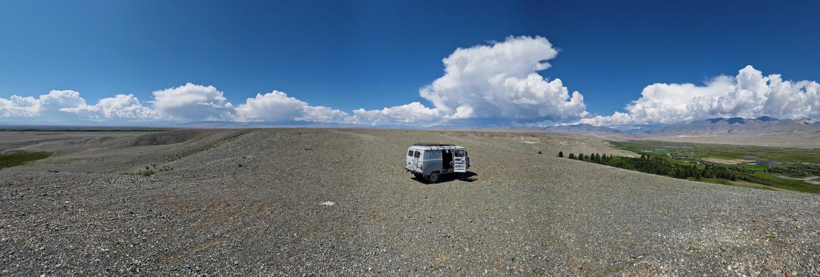

Why rules and guidelines?

Slide 11
Coding Best Practices
Portability
Automated Testing
Rich Data Structures
Modular
Reusability
Style / Indentation
Scalability
Camel case
Pascal case
Naming Convention

Slide 12
Your PowerShell Patterns / Tools
Instrumentation
Profiling
Custom Objects
Splatting
Regular Expressions
PassThru
Pipeline Support
Classes
CmdletBinding
Linting
PSScriptAnalyzer
Parameter Sets
Variables
Pester
Markdown
Modules
System Variables
SupportsShouldProcess
Parameters
Mandatory
Pipeline Support
Validation
Comment-Based Help
Configuration
Functions
Flow Control
(Cyclomatic Complexity)
Verbose and
Debug Logging
Git

Slide 13
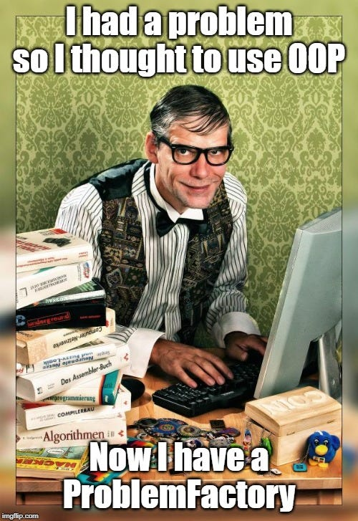
Not every pattern is the right one
Some people, when confronted with a problem, think "I know, I'll use regular expressions." Now they have two problems. (blog.codinghorror.com)
Using PowerShell Classes the
wrong way may result in:

Slide 14
raandree/PowerShellTraining (github.com)
PoshCode/PowerShellPracticeAndStyle: The Unofficial PowerShell Best Practices and Style Guide (github.com)
Style Guidelines (dsccommunity.org)
gaelcolas/Sampler: Module template with build pipeline and examples, including DSC elements. (github.com)

Slide 15
Demos
We love Demos!

Slide 16
Don’ts
Hard code values of any kind
Global or parent scope variables
Variable and functions in non-English language
Store orphaned code in productive scripts

Slide 17
Dos
Start with functions, not scripts and move to modules.
Support the pipeline from the beginning.
Invest some time in parameter design.
Harmonize parameter names.
Implement -PassThru and -Verbose when applicable.
Return data with context (classes or PSCustomObject).
Agree on a code style and always apply it.
Always use git.

Slide 18
Q&A
15 minutes

